Slide 1

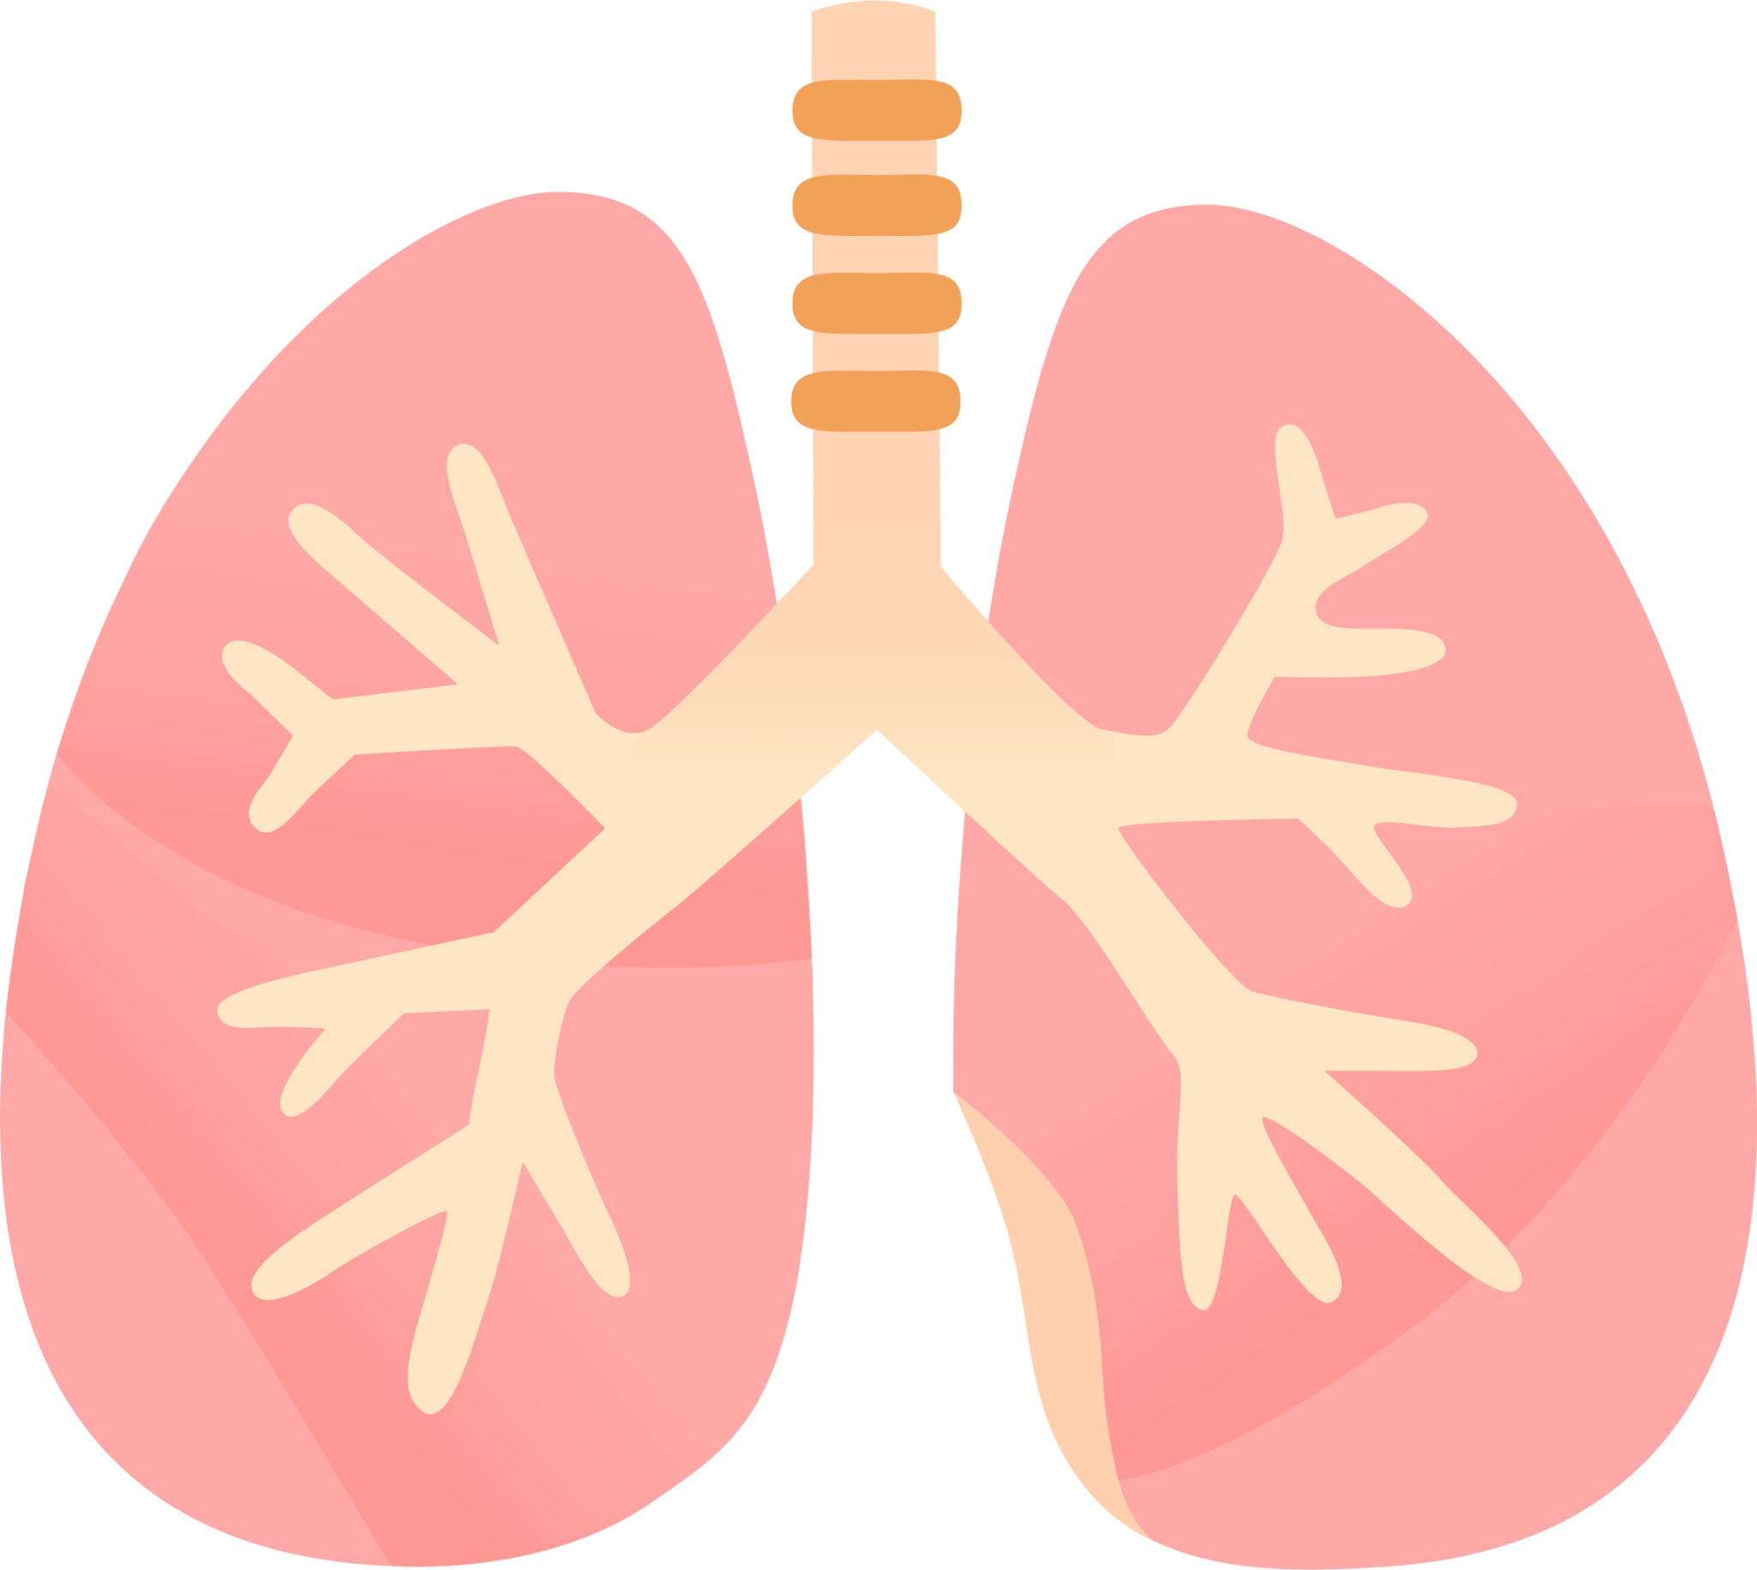
LUNG SOUND RECORDER
Team: Quad-Core Squad
By: Karthik, Aryanil, Anurag, and Adithya
Professor: Abhishek
TA: Srikar, Santhoshini
Week-1

Slide 2


Resources Used
Slide by Karthik Venkat Malavathula
YouTube Video
Sonic Visualiser

Slide 3


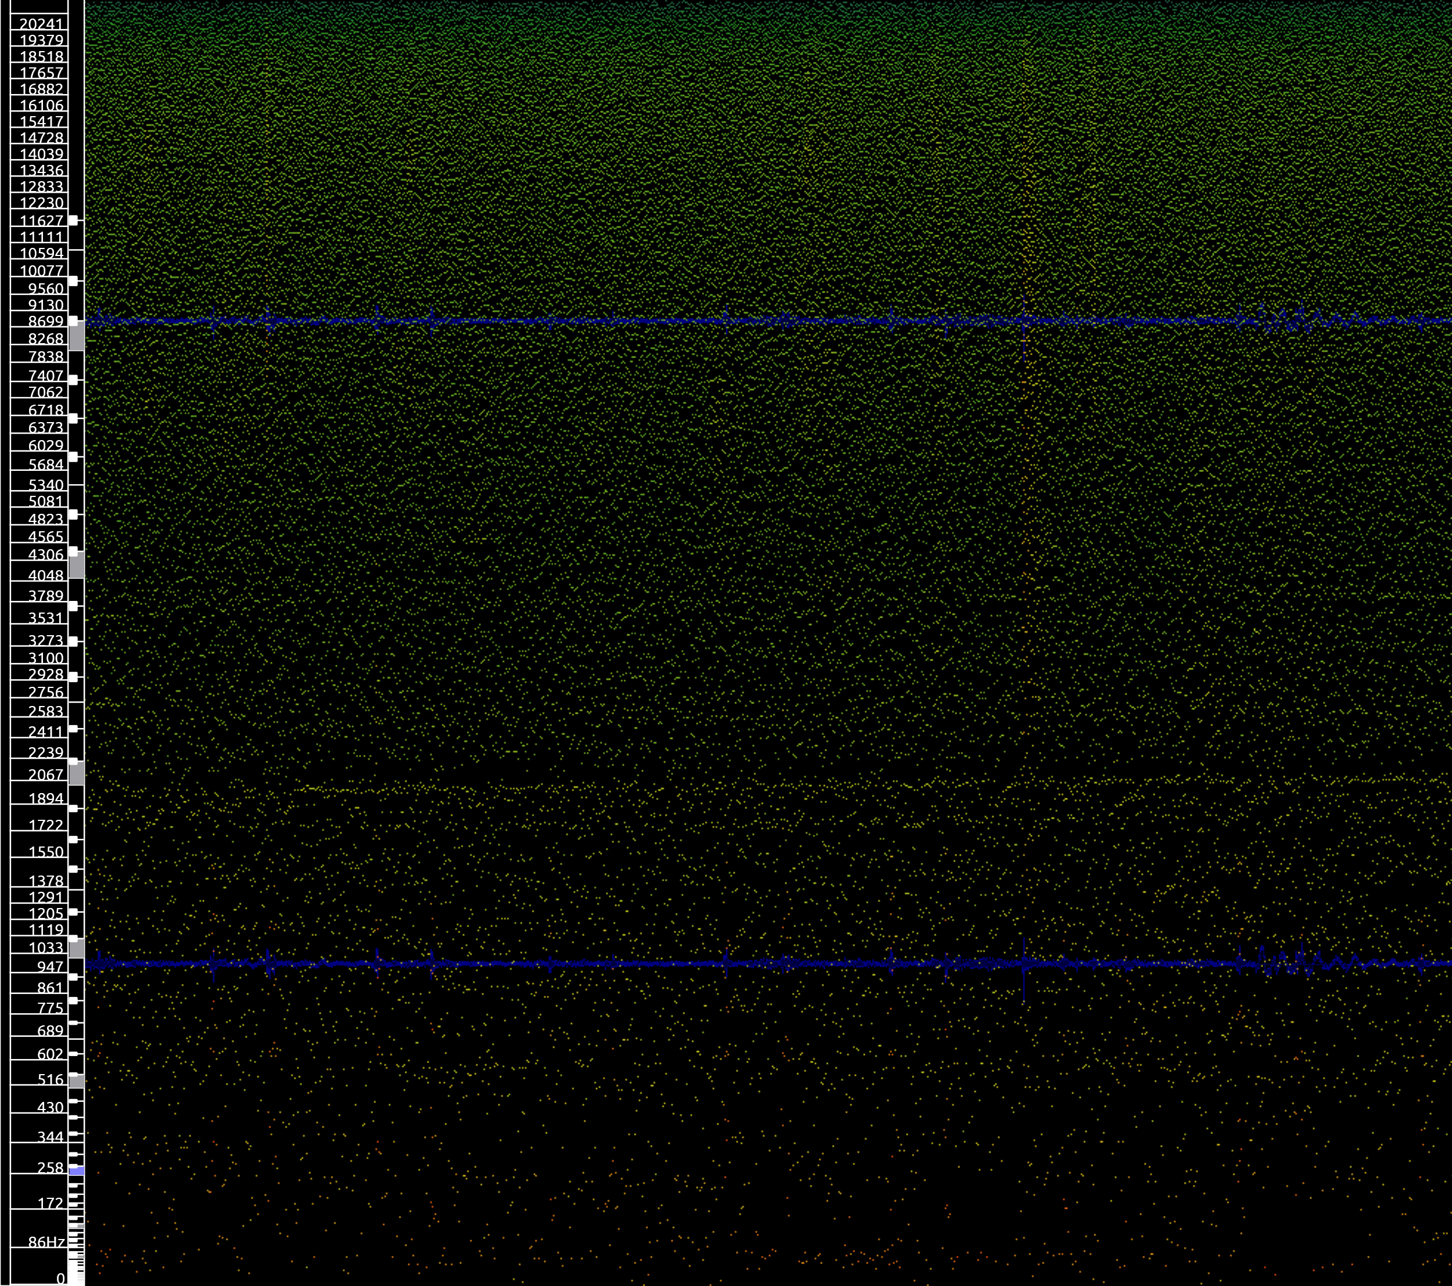
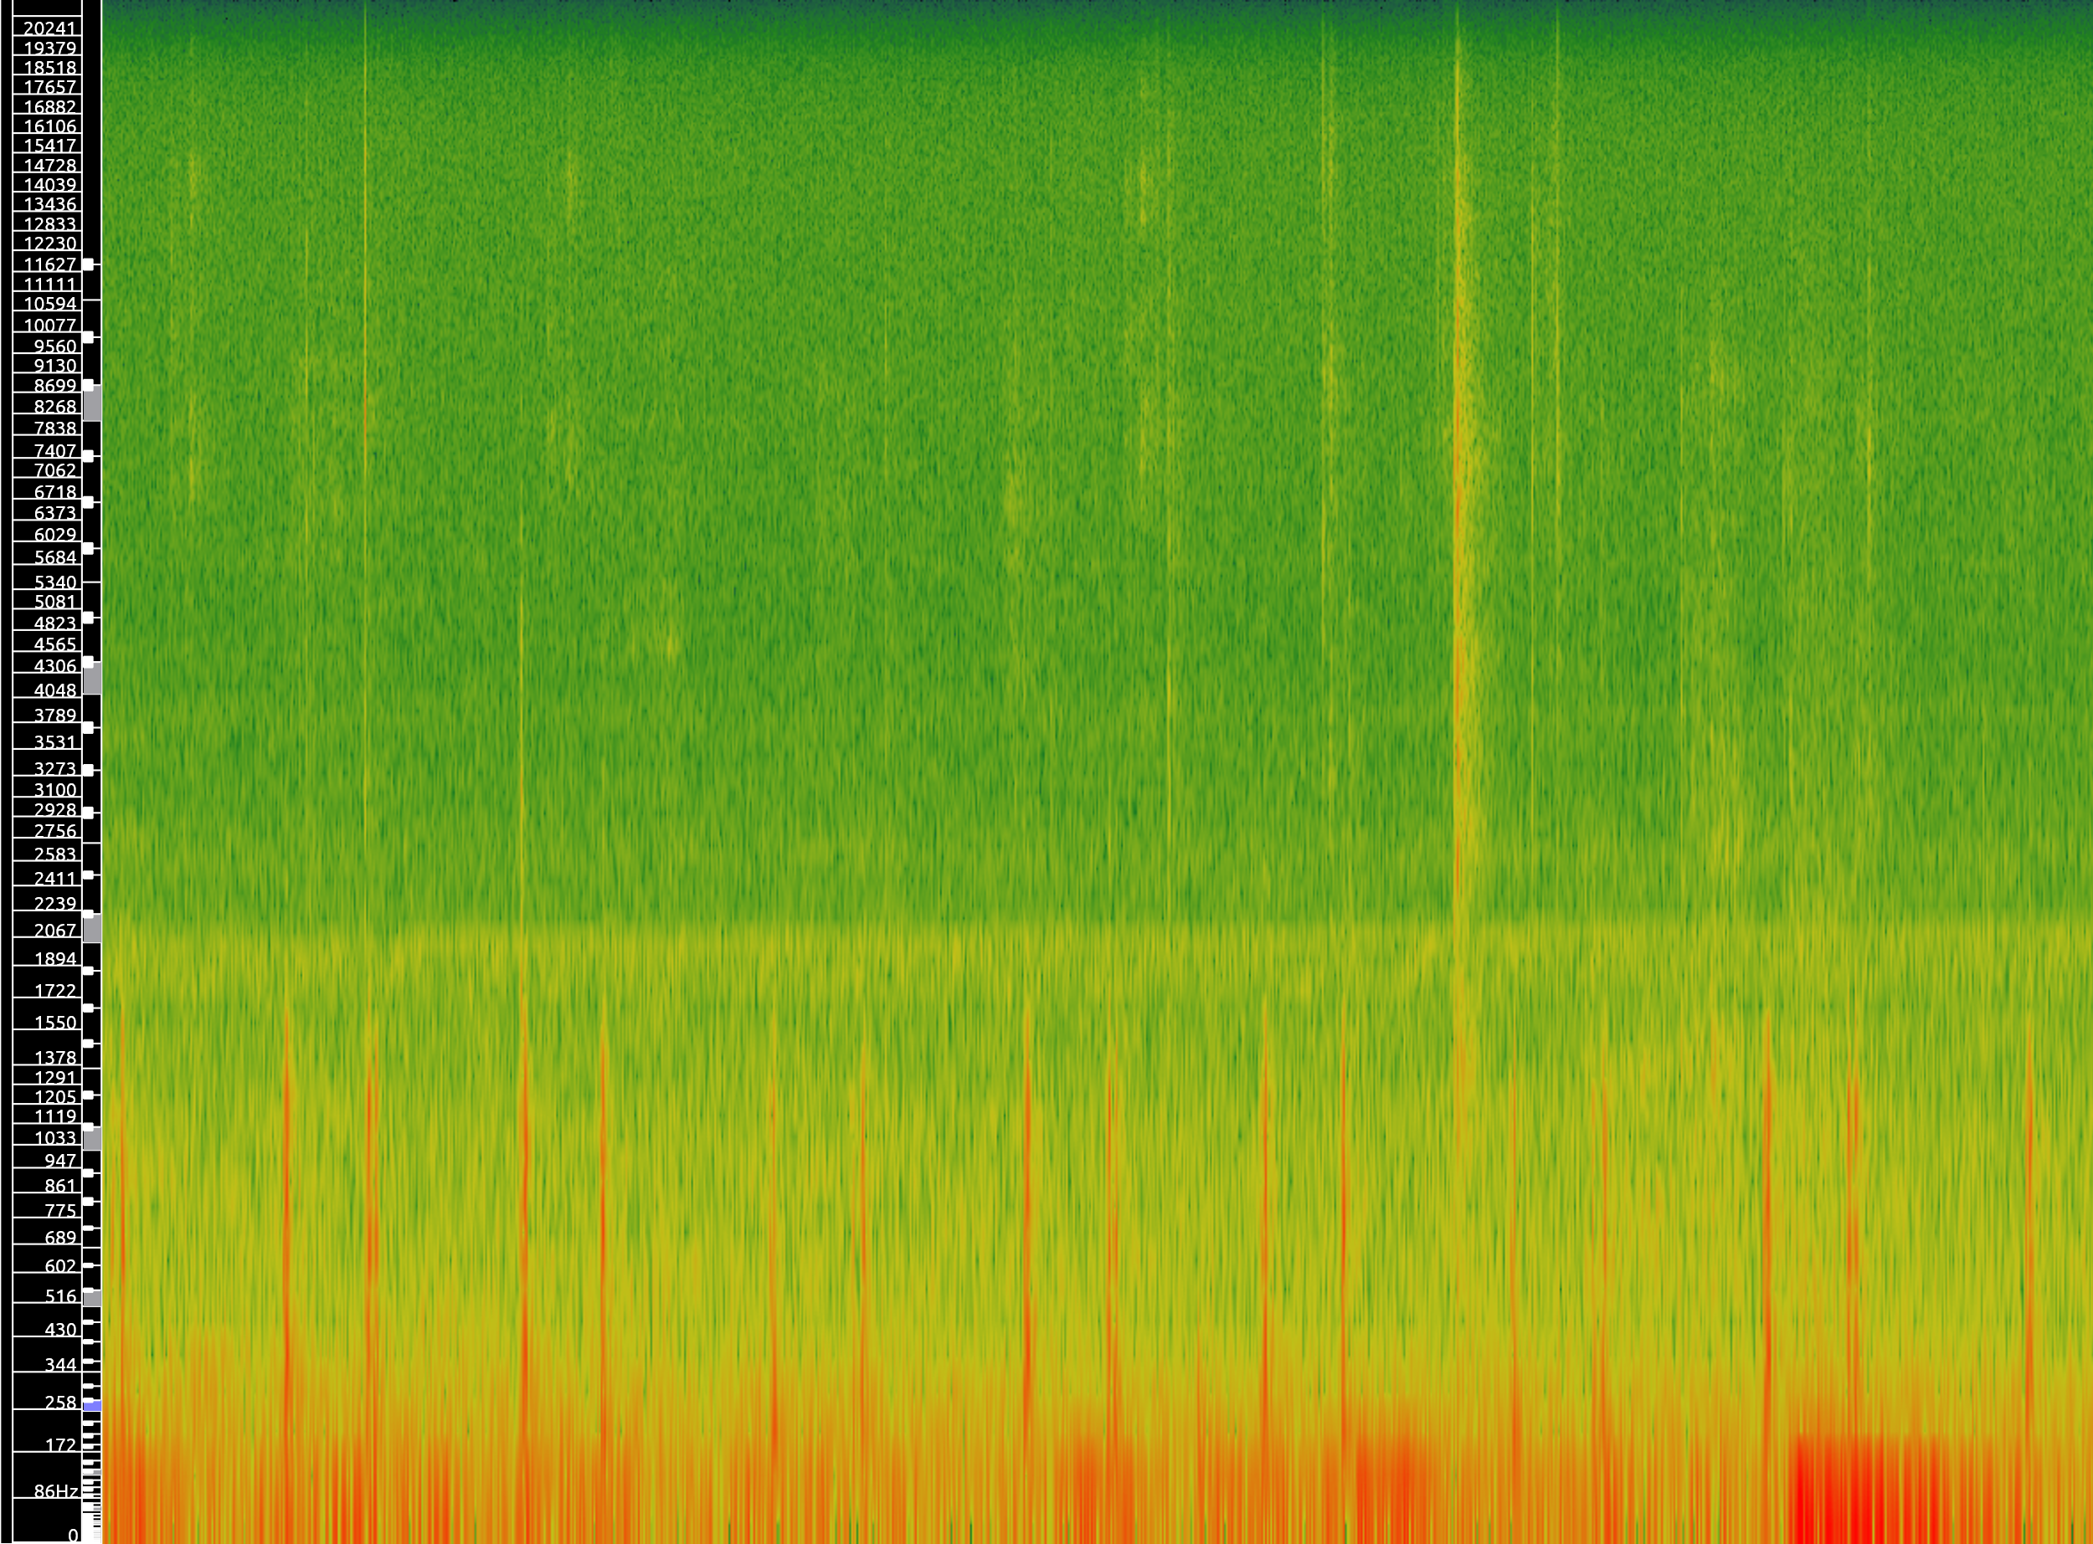
Environment 1: Little Disturbance
Slide by Karthik Venkat Malavathula

Slide 5
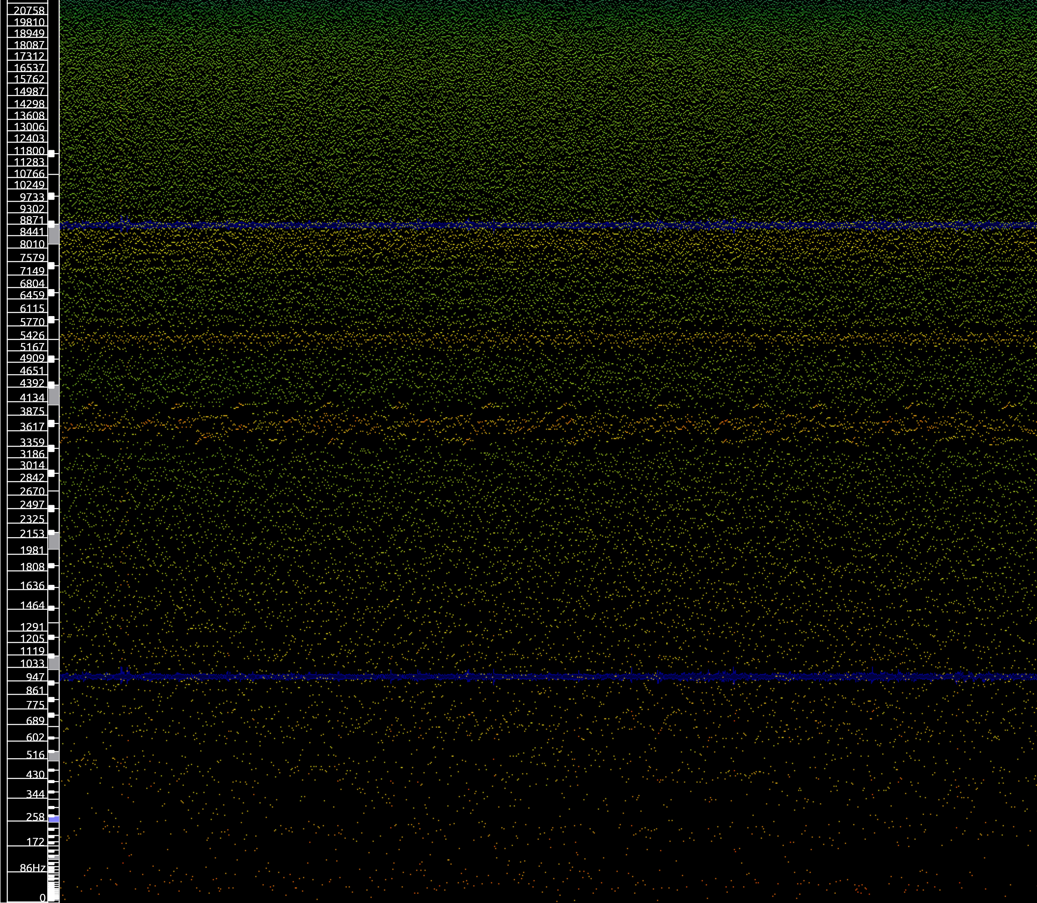
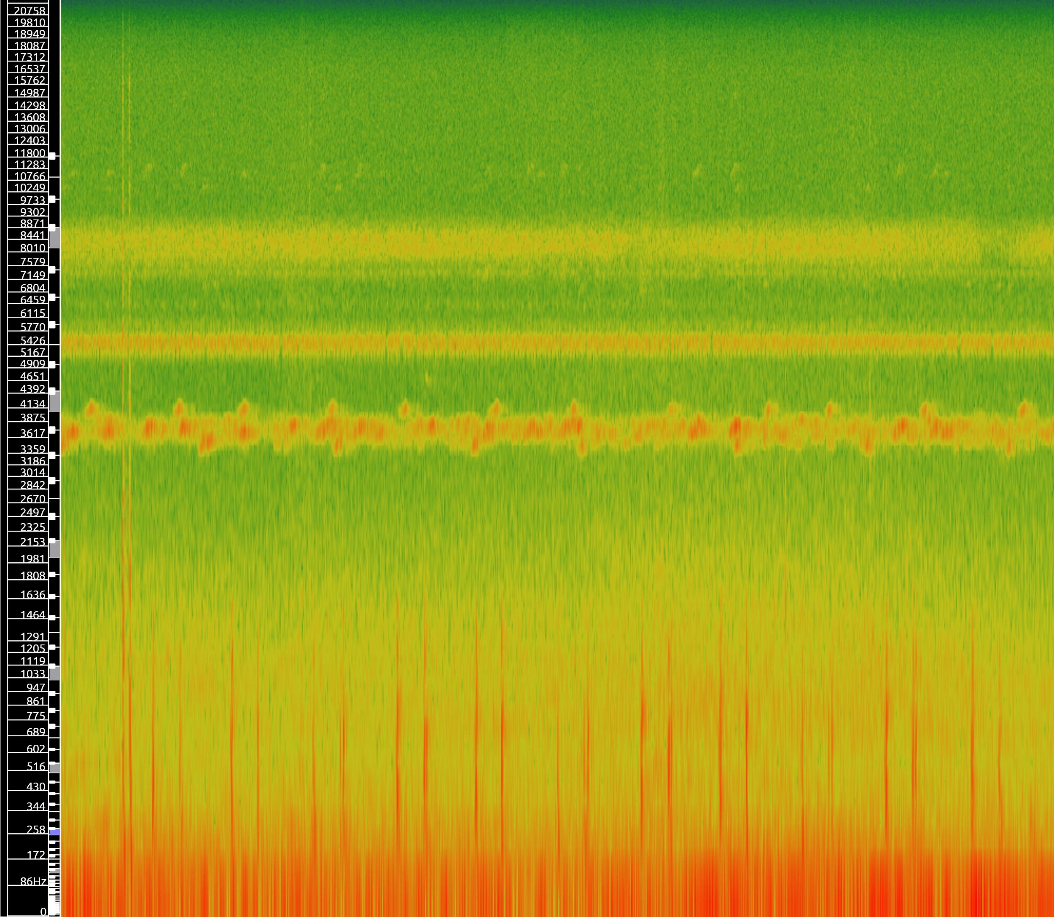
Slide by Karthik Venkat Malavathula
Environment 2: Medium Noise

Slide 6
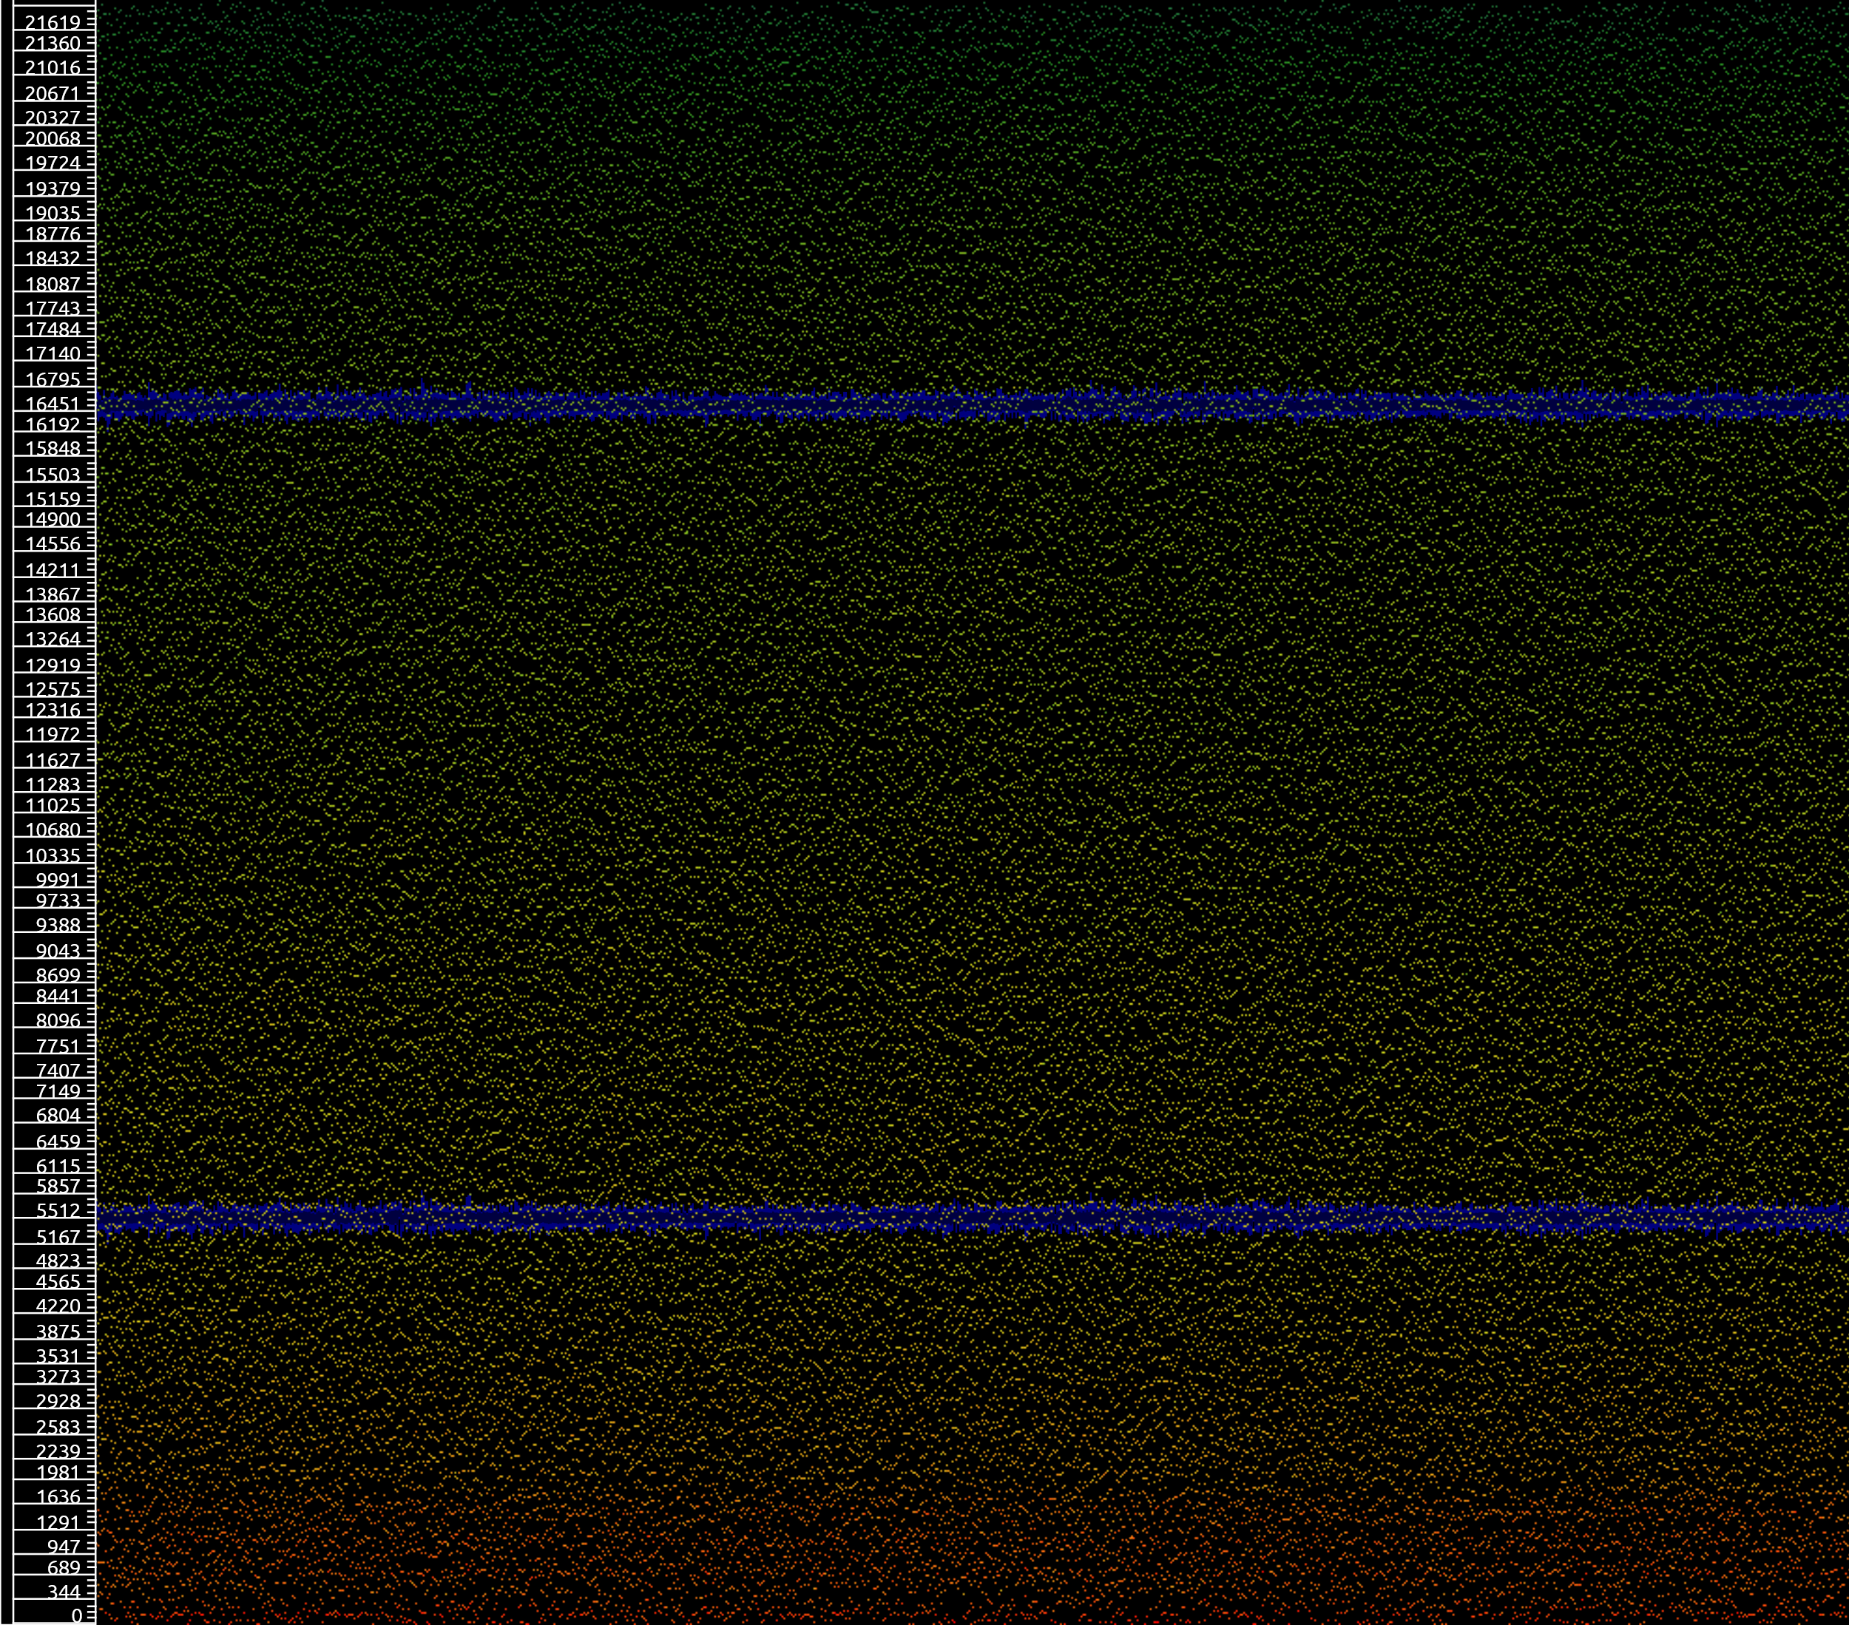
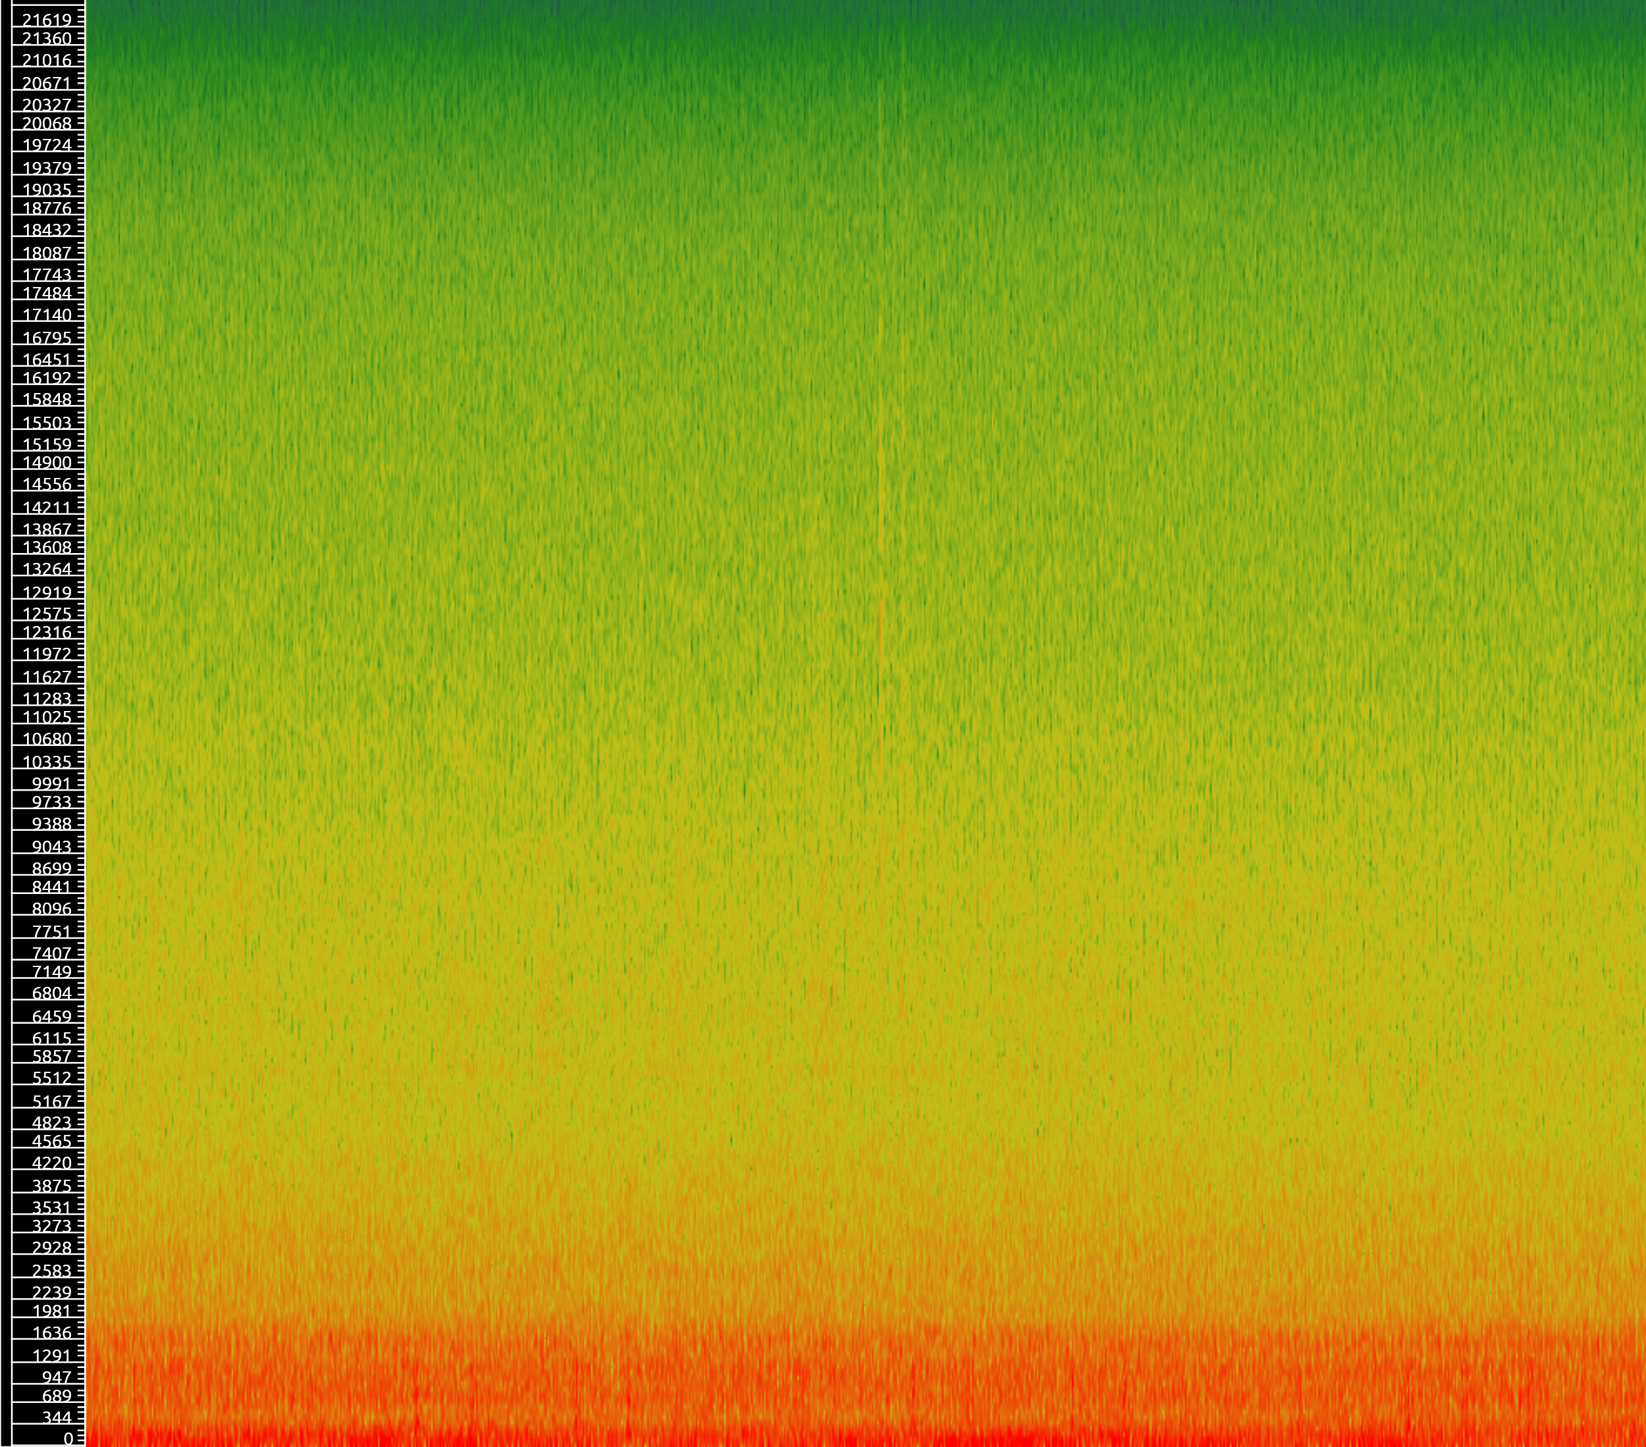
Slide by Karthik Venkat Malavathula
Environment 3: Loud Noise

Slide 7
Future Steps and Challenges Faced
Slide by Karthik Venkat Malavathula
Future Steps:
We need to record audio using the mic and ESP32.
We need to create a file storage system to handle audio files recorded by the mic, as there is too little storage space in ESP32.
Challenges:
It was a prolonged effort to find the appropriate video
We had to navigate the app, and we needed to learn all its controls
We had to retry many times to get a good quality recording, as we wanted good quality test cases

Slide 8
Band-Pass filter
By Anurag

Slide 9
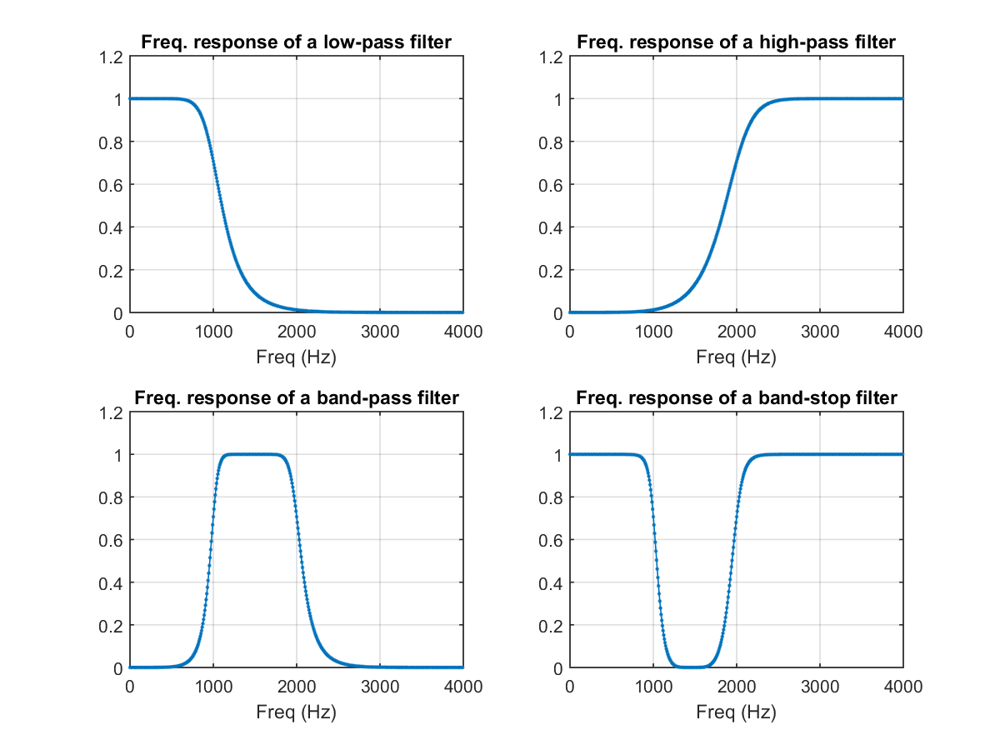
What is a Band-Pass filter?
A band-pass filter is a signal filter that attenuates frequencies outside a given range.
It functions as a small window.
It is a combination of low-pass and high-pass filters.
Anurag
Image Credit: Analog IC tips

Slide 10
Band-Pass filter implementation
In python using SciPy, librosa and soundfile
Used a Butterworth filter
Low cut frequency: 10 Hz
High cut frequency: 400 Hz
Heart beats are usually in the 20 – 250 Hz range
Sampling rate: 5000 Hz
Order: 6
Anurag

Slide 11
Results – Low noise
Before
After
Anurag

Slide 12
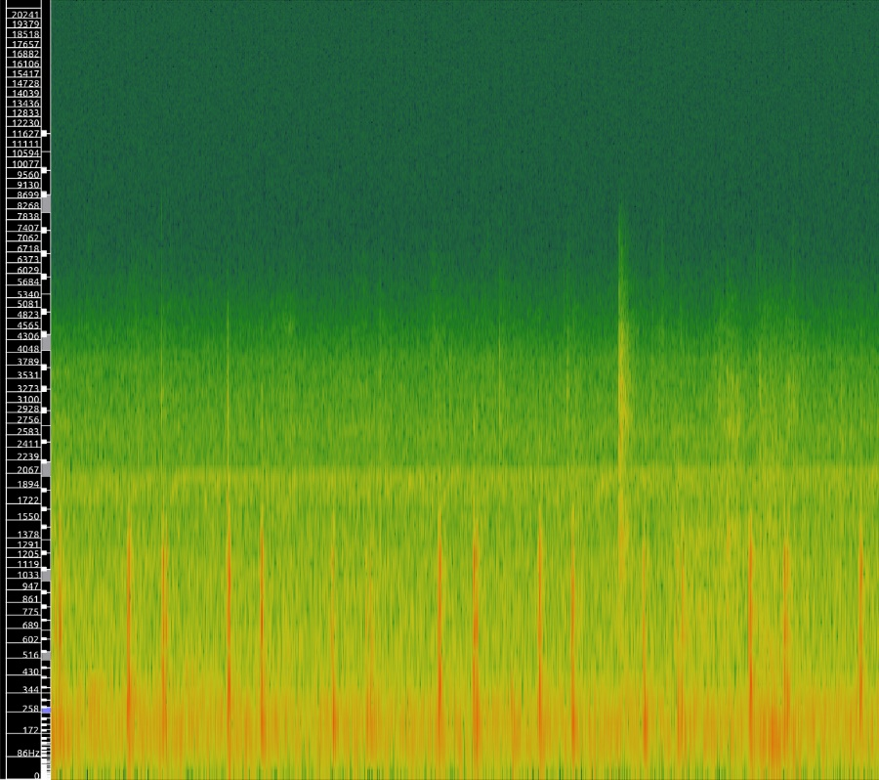
Results – Low noise
Before
After
Anurag

Slide 13
Results – Medium noise
Before
After
Anurag

Slide 14
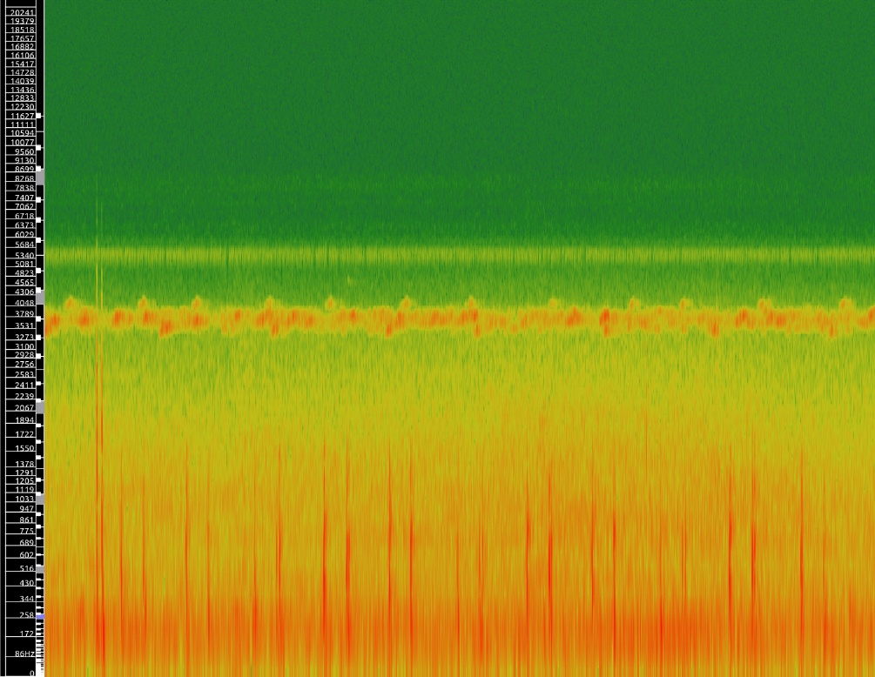
Results – Medium noise
Before
After
Anurag

Slide 15
Results – Loud noise
Before
After
Anurag

Slide 16
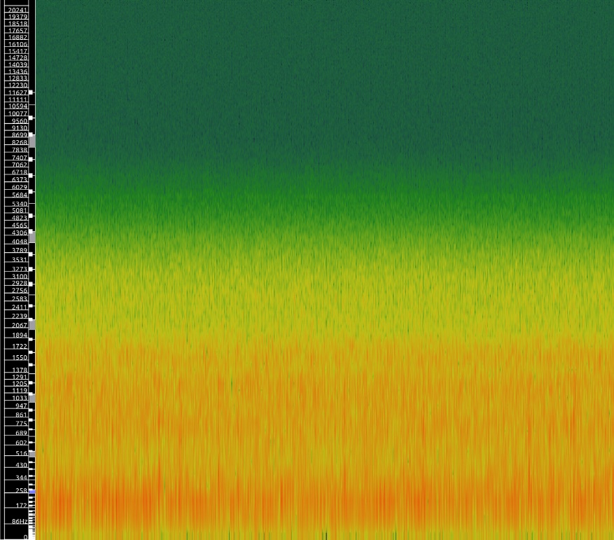
Results – Loud noise
Before
After
Anurag

Slide 17
Observations
The filter did a decently good job of removing unwanted frequencies.
However, it still left quite a bit of noise.
Low frequency noise still permeated through regardless.
The band-pass filter can be used as the first layer filter, but it is not enough
Anurag

Slide 18
Band-Pass filter - References
https://www.geeksforgeeks.org/band-pass-filter/
https://scipy-cookbook.readthedocs.io/items/ButterworthBandpass.html
https://stackoverflow.com/questions/12093594/how-to-implement-band-pass-butterworth-filter-with-scipy-signal-butter
https://dsp.stackexchange.com/questions/60455/how-to-choose-order-and-cut-off-frequency-for-low-pass-butterworth-filter
Anurag

Slide 19
Wavelet Transform
[1]
By Aryanil

Slide 20
What exactly is Wavelet transform?
1. Wavelet transform is a powerful mathematical tool used for analyzing signals or data. It decomposes a signal into its constituent wavelets, which are small wave-like oscillations
It can be performed in 4 basic steps:
A) Wavelet Basis Functions
B) Decomposition
C) Multi- Resolution Analysis
D) Reconstruction
Aryanil

Slide 21
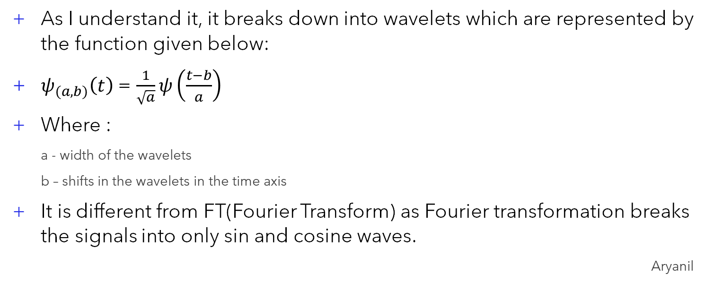
Wavelet Basis Functions
[2]
As I understand it, it breaks down into wavelets which are represented by the function given below:
$ψ_{(a,b)}\left(t\right)$ = $\frac{1}{\sqrt{a}}ψ\left(\frac{t−b}{a}\right)$
Where :
a - width of the wavelets
b – shifts in the wavelets in the time axis
It is different from FT(Fourier Transform) as Fourier transformation breaks the signals into only sin and cosine waves.
Aryanil

Slide 22
Decomposition
Decomposition process in wavelet transforms is done in following steps:
Wavelet Filters: Apply low-pass (approximation) and high-pass (detail) filters to the signal.
Convolution: Convolve the signal with these filters to extract approximation and detail coefficients.
Downsampling: Reduce the number of data points by keeping every other sample to capture different frequency bands.
Recursive Decomposition: Apply the same filters to the low-pass approximation coefficients to obtain additional levels of approximation and detail.
Aryanil

Slide 23
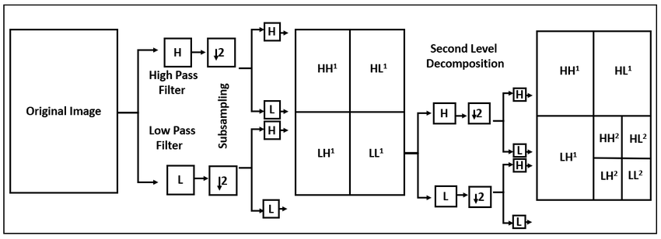
Two-level wavelet decomposition structure (recursive filtering and subsampling).
[1]
Aryanil

Slide 24
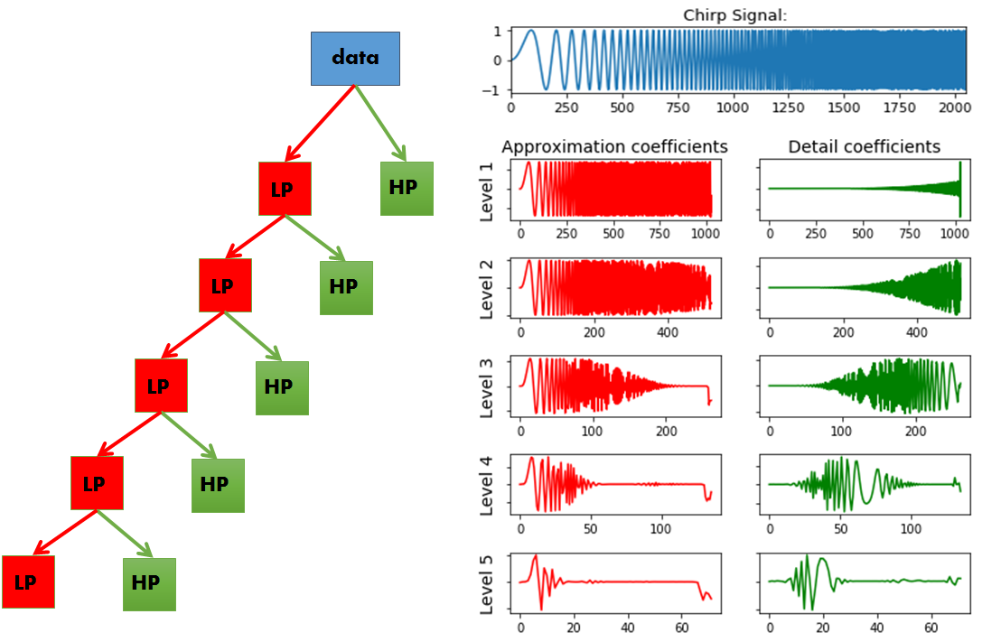
Multi- Resolution Analysis
Aryanil

Slide 25
Reconstruction
For every level of coefficient they can be tweaked or smoothened out to the closest curve and then be reconstructed back.
This is done by using inverse-wavelet function and during this we can include/ignore the desired frequencies.
In our case the heart beats are low, so we apply low band filter and get the desired signals
Aryanil

Slide 26
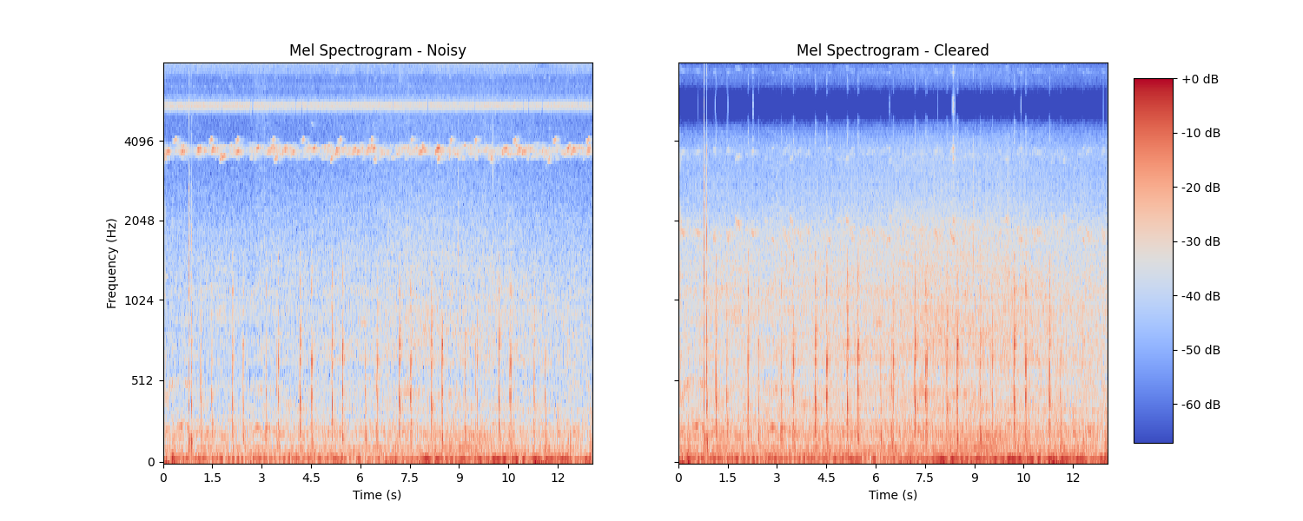
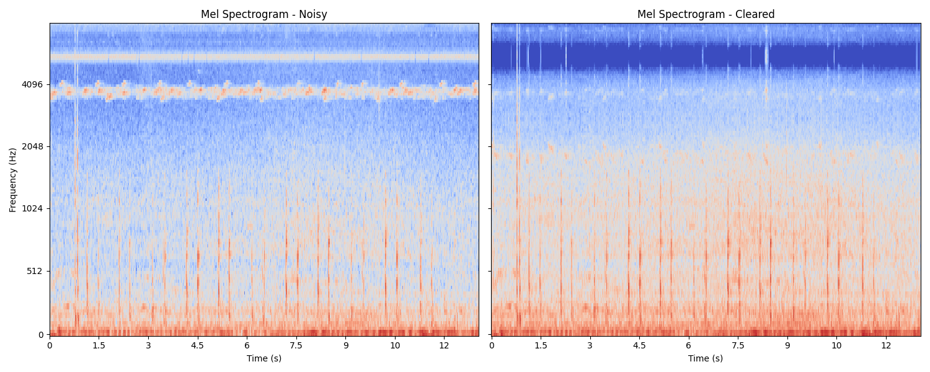
Mel Spectrogram Before and after for Medium-Noise
Code Source: Github Course Project
Aryanil

Slide 27

Results (Low noise)
Before
After
Aryanil

Slide 28
Results (Medium noise)
Before
After
Aryanil

Slide 29
Results (Loud noise)
Before
After
Aryanil

Slide 30
Sources :
[1] – Wikipedia
[2] – ScienceDirect( The formula)
[3] – Recursive Decomposition
[4] – Librosa
[5] – Paper on Wavelet Transformation of lung sounds
Aryanil

Slide 31
Spectral Gating
Adithya

Slide 32
Need for Spectral Gating
As mentioned in earlier slides, a band pass filter proves to be quite useful in filtering out sounds outside a desired frequency window
However, our observations conclude that another layer of filtering is required
Spectral gating is a potential next filtering layer
Adithya

Slide 33
What is Spectral Gating
Spectral Gating is a noise reduction technique used in audio processing to reduce unwanted background noise while preserving the desired signal.
It involves analyzing the frequency spectrogram generated by applying a Fourier transformation and applying gates on it and obtaining the audio signal by performing the inverse Fourier transformation on the modified spectogram.
Adithya

Slide 34
How spectral gating works
Essentially we wish to convert the audio signal from a time domain to a frequency domain for analyzing it.
Sound in the real world consists of a multitude of such pure signals. It is difficult to, therefore, apply frequency related operations to it. To decompose a complex sound to its constituent frequencies, Fourier transformation is used
Adithya

Slide 35
How spectral gating works
The audio signal is divided into small overlapping segments (windows). Using small windows of the audio signal for applying a Fourier transformation is what is referred to as the Short Time Fourier Transformation(STFT)
Adithya

Slide 36
How Spectral Gating works?
We convert the y-axis (frequency) to a log scale and the color dimension (amplitude) to decibels to form the spectrogram.

Slide 37
How spectral gating works
After obtaining the spectogram, gates are then applied (threshold on the amplitude) to filter out noise whose amplitude is lower than that of the estimated threshold
After analyzing the spectogram (whose domain is frequency) , we can apply an inverse Fourier transformation to obtain a new modified audio signal(whose domain is time).
Adithya

Slide 38
How spectral gating works
Note that this is based on the assumption that the sounds with lower amplitude are noise, one which is justifiable after applying the band pass filter.
Adithya

Slide 39
How to apply Spectral Gating
By importing the noise reduce library and applying the filtering function on the .wav file which was produced after applying the band pass filter on the original unfiltered .wav file.
Adithya

Slide 40
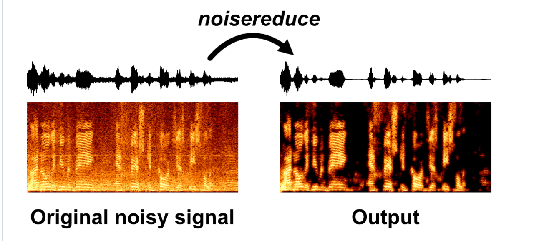
Illustration

Slide 41
Results-Low Noise
Before After

Slide 42
Results-Medium Noise
Before After

Slide 43
Results – Loud Noise
Before
After

Slide 44
Reference links
https://emerginginvestigators.org/articles/22-262/pdf
https://en.wikipedia.org/wiki/Short-time_Fourier_transform
https://github.com/timsainb/noisereduce
https://medium.com/analytics-vidhya/understanding-the-mel-spectrogram-fca2afa2ce53
Adithya

Slide 45
Targets for next week
Implementing the mic to record
Testing combination of mic and stethoscope
Mixing various methods to get optimal noise reduction
Making the whole process automated (from recording to noise reduction)

Slide 46
Thank You !!

